Slide 1

Scrape and analyse customer review data to uncover insights for British Airways
25/09/2023
- Amey Desai

Slide 2
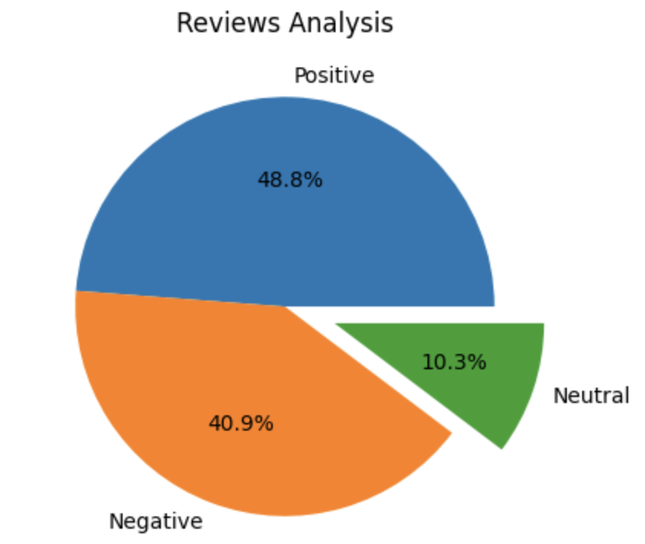
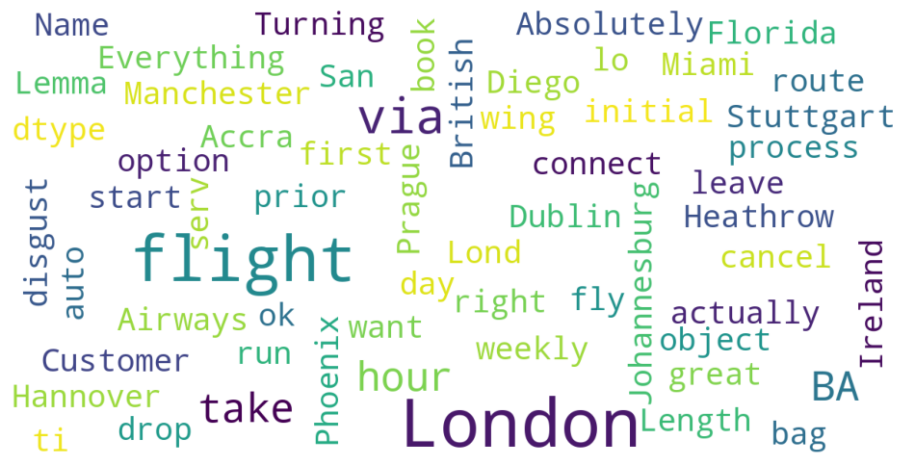
INSIGHTS FROM CUSTOMER REVIEWS
From cleaning 1000 reviews given by the customers, we obtained Sentiment Analysis which is :-
Positive Reviews :- 488
Negative Reviews: - 409
Neutral Reviews :- 103
Word cloud of keywords used in reviews:-

